Slide 1

PROJECT EXCEL-PPT
Astro-Sage Analysis
Presentation by: Aksh Yadav
Project Submitted to Newton School of Technology
Date: 14/03/2026

Slide 2
INTRODUCTION
The product that started as a simple Kundli generator now claims millions of daily users — showing how a niche service became mainstream via mobile apps.
AstroSage built an astrologer marketplace of ~700,000 registered astrologers (massive supply-side scale).
AstroSage began as a tech-first approach to Vedic astrology and has grown into one of India’s largest digital astrology platforms by combining traditional jyotish with mobile apps, AI tools and a marketplace for astrologers.
So astrosage received a 1 crore investment so are aim is to optimizing the call center operations, increasing efficiency, customer satisfaction and make it profitable.
With this objective we are going to analyze the trends and how the marketplace is growing to invest the large amount in the necessary service to make it scalable and profitable.

Slide 3
DATA OVERVIEW
As we know data is oil for any analysis to understand the data is most important.
Getting the raw data won’t make analysis correct. We need to clean the dataset for the analysis.
Removed the duplicates to avoid overcounting.
Handle missing values and filled with average/mean/mode.
Remove the columns with large data missing.
Corrected categorical inconsistencies (agent names, call status labels).
Validated the cleaned dataset for the analysis.
This cleaned data derive many matrices and very important to any kind of analysis for the product in the company and their services.
Some key factors-
Enables identification of peak demand periods.
Helps evaluate agent efficiency and service quality.
Supports data-driven decisions for expansion and investment planning.

Slide 4
METHODOLOGY
Analytical Methods & Tools Used
Data Cleaning & Preparation:
Remove duplicates
Handle Blanks
Standardized correct format
Tools Used:
Is blank, Average, Trim, Find and Replace, Formatting
Trend & Comparative Analysis:
Patterns and changes over time were analyzed to support decision-making:
Day-by-day and month-by-month call trends
Comparison of agent workload to detect:
Overloaded agents (burnout risk)
Underutilized agents (capacity available)
Function Used:
Pivot tables and Charts Extensively.

Slide 5
ANALYSIS
The distribution shows how users access services across different platforms.
A majority of users prefer Gurucool (72%), while fewer use the app (28%), and almost none use the dashboard (0%).
This indicates a strong user preference toward the Gurucool platform for availing services.
Resource Allocation: Assign more agents (gurus) to Gurucool since it handles the highest demand.
Business Focus: Invest more in Gurucool platform enhancements as it drives maximum engagement.

Slide 6
ANALYSIS
Revenue is heavily dominated by Call consultations, making it the primary revenue driver.
Chat contributes significantly less, while public live calls generate negligible or no revenue.
High-value channel: Call services generate the majority of revenue → customers prefer personalized interaction.
Use chat as a funnel → convert users into higher-value call consultations.

Slide 7
ANALYSIS
Call volume increases from early morning and peaks between 6 AM – 10 AM and 2 PM – 5 PM.
Call activity drops significantly during late evening and night hours (after 7 PM).
Peak demand windows: Morning and afternoon are high-load periods → maximum customer activity.
Low utilization periods: Night hours have very low call volume → resources may be underutilized.
Allocate more agents during peak hours (6–10 AM, 2–5 PM) and reduce staffing at night.

Slide 8
ANALYSIS
Call volume shows fluctuating trends, with a noticeable dip in the first week and a peak around mid-month (~1300+).
Towards the end of the month, call volume becomes unstable with sharp drops, indicating inconsistent demand.
Mid-month surge: Higher engagement during the middle of the month → possible link to user behavior (salary cycle, offers, or demand spikes).
Prepare for mid-month spikes by increasing agent availability in advance.

Slide 9
ANALYSIS
A large number of users have given a rating of 0, indicating missing feedback or poor experience.
Most ratings are concentrated between 2–3, while higher ratings (6–8) are relatively low.
Customer dissatisfaction / no feedback issue: High count at 0 suggests users are either not rating or are disengaged.
Focus on improving service quality to shift users from low ratings (2–3) to higher ratings.

Slide 10
ANALYSIS
A significant number of gurus have a rating of 0, indicating missing ratings or unassessed performance.
Most gurus fall within the 2–3 rating range, with relatively fewer in higher rating bands (6–8).
Performance visibility gap: High 0 ratings suggest many gurus are not being evaluated → lack of proper tracking.
Ensure every consultation is rated to eliminate 0-rating gaps.

Slide 11
Strategic Recommendations
According to my analysis the recommendation are as follows:-
No need to hire new agents; focus on improving existing workforce efficiency.
Provide regular training and evaluate agent performance based on ratings.
Distribute agents effectively during peak periods to prevent burnout.
Invest in improving call services to reduce missed, busy, or incomplete calls.
Shift focus from saturated chat support to call services for better revenue opportunities.
Use call interactions to promote complementary services and increase conversions.
Implement proper monitoring systems to track and improve agent performance.
Invest in AI chatbots to enhance operational efficiency and support.

Slide 12
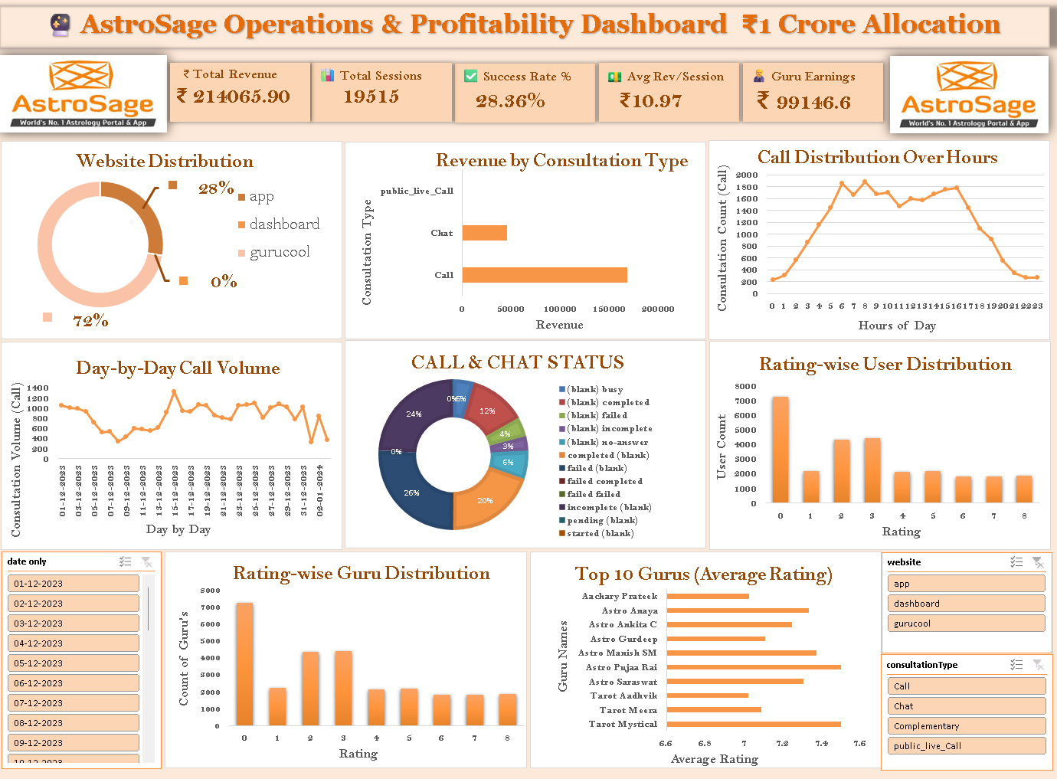
Dashboard And Visualizations
The dashboard gives an overall view of daily revenue, session status, top rated guru and much more analysis at one place.
It shows region-wise call distribution, highlighting where most customer demand comes from.
Guru-wise revenue analysis helps identify top-performing and high-earning gurus.
Year-wise monthly trends reveal growth patterns and demand changes over time.
Average ratings help track customer satisfaction and service quality.

Slide 13
Conclusion
_{Using table to conclude:-}
Key findings | Their Implications
Calls generated the highest net amount. | Investment should be on sales.
Burnout risk of the agents and no need of hiring agents. | Proper distribution of agents.
Customer satisfaction is poor with overload work agents. | Proper training should be given and performance analysis on regular basis.
Technology Enhancement | Implementation of AI chatbot/Agents.
Astro guru data should be benchmarked with Astro sage. | Because to analyze the competitive business area and implementation of the services in that area.

Slide 14

Acknowledgement
I will acknowledge the Newton school of Technology for giving me this opportunity to work on a real-world problems. Also, for providing me the raw data for the analysis.
I will thank Mr. Vijay sir for this excel module who makes us to understand all the concepts of excel and their advanced functions.
In last I will thank my course advisor Mr. Aditya for helping me through out this module and project.

Slide 15


